Slide 1
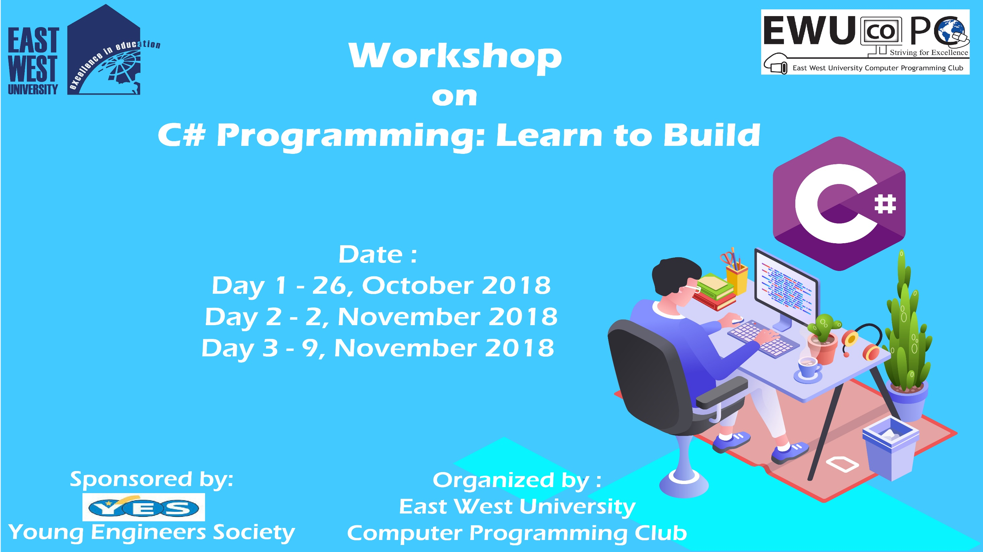

Slide 2
C# Day 2 Lecture11: Class

Slide 3
Class: Define
class first
{
public static int number1;
public int number2;
public int show()
{
return number1+number2;
}
}

Slide 4
Class: Define
public class Person
{
public string Name { get; set; }
public int Age { get; set; }
public Person(string name, int age)
{
Name = name;
Age = age;
}
}

Slide 5
Class: Instance
class Program
{
static void Main()
{
Person person1 = new Person("Leopold", 6);
Console.WriteLine("person1 Name = {0} Age = {1}", person1.Name, person1.Age);
Person person2 = person1;
person2.Name = "Molly"; person2.Age = 16;
Console.WriteLine("person2 Name = {0} Age = {1}", person2.Name, person2.Age);
Console.WriteLine("person1 Name = {0} Age = {1}", person1.Name, person1.Age);
Console.WriteLine("Press any key to exit.");
Console.ReadKey();
}
}

Slide 6
Class: Static Keyword
class Program
{
static void Main(string[] args)
{
first f = new first();
f.number2 = 20;
first.number1 = 100;
Console.WriteLine( f.show());
}
}
}

Slide 7
Class: Namespace
namespace Class_2nd_Batch
{
class MyClass {
public int a ;
public static int b = 20;
public void Show()
{
Console.WriteLine(a+b);
}
}

Slide 8
Class: Constructor
class Program
{
static void Main(string[] args)
{
MyClass obj = new MyClass();
MyClass.b = 200;
obj.a = 100;
obj.Show();
MyClass obj1 = new MyClass();
obj1.a = 20;
obj1.Show();
Console.ReadKey();
}
}

Slide 9
This slide is provided as a course material in the workshop named “Workshop on C# Programming: Learn to Build”.
Organized by-
East West University Computer Programming Club (EWUCoPC)
Prepared by- Jannat Binta Alam
Campus Ambassador
Young Engineers Society (YES)
E-mail: jannat.cse.ewu@gmail.com

